Slide 1
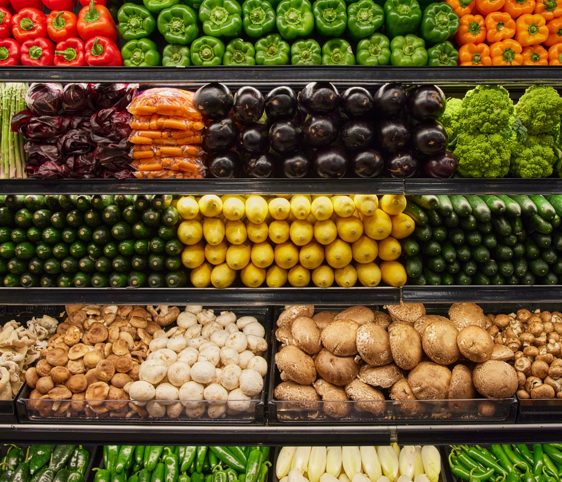
FARMLINK: Breaking Out of the Farmer’s Market
TEAM 7: Madison Huang, Sunny Yu, Peter Lee, Andrew Lee, Teddy Hickenlooper, Vardhan Agrawal
10/14/25

Slide 2
Team: MADI
Introduce team members and their skills and/or special knowledge.
Introduction (1 min): MADI
Importance of the product/initiative
Problem Statement: Vardhan
Define the problem/opportunity.
Support with data/examples.
DRAFT Solution: Andrew
Product features and benefits.
Include visuals/prototypes if possible.
Business Model
Market Analysis (1 min): Peter
Target market and size.
Competitive landscape and differentiation.
Financial Projections:
Revenue projections and TAM/SAM/SOM.
Ask and Next Steps: Sunny
Request to the product council (approval, resources, etc.).
Appendix (Optional):
Extra details like financials or technical specs.
Special regulatory or legal needs
Relevant extra research

Slide 3
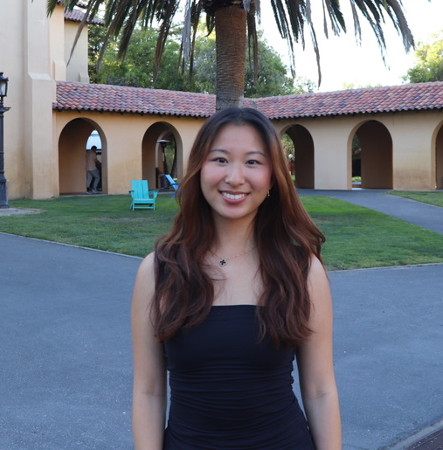
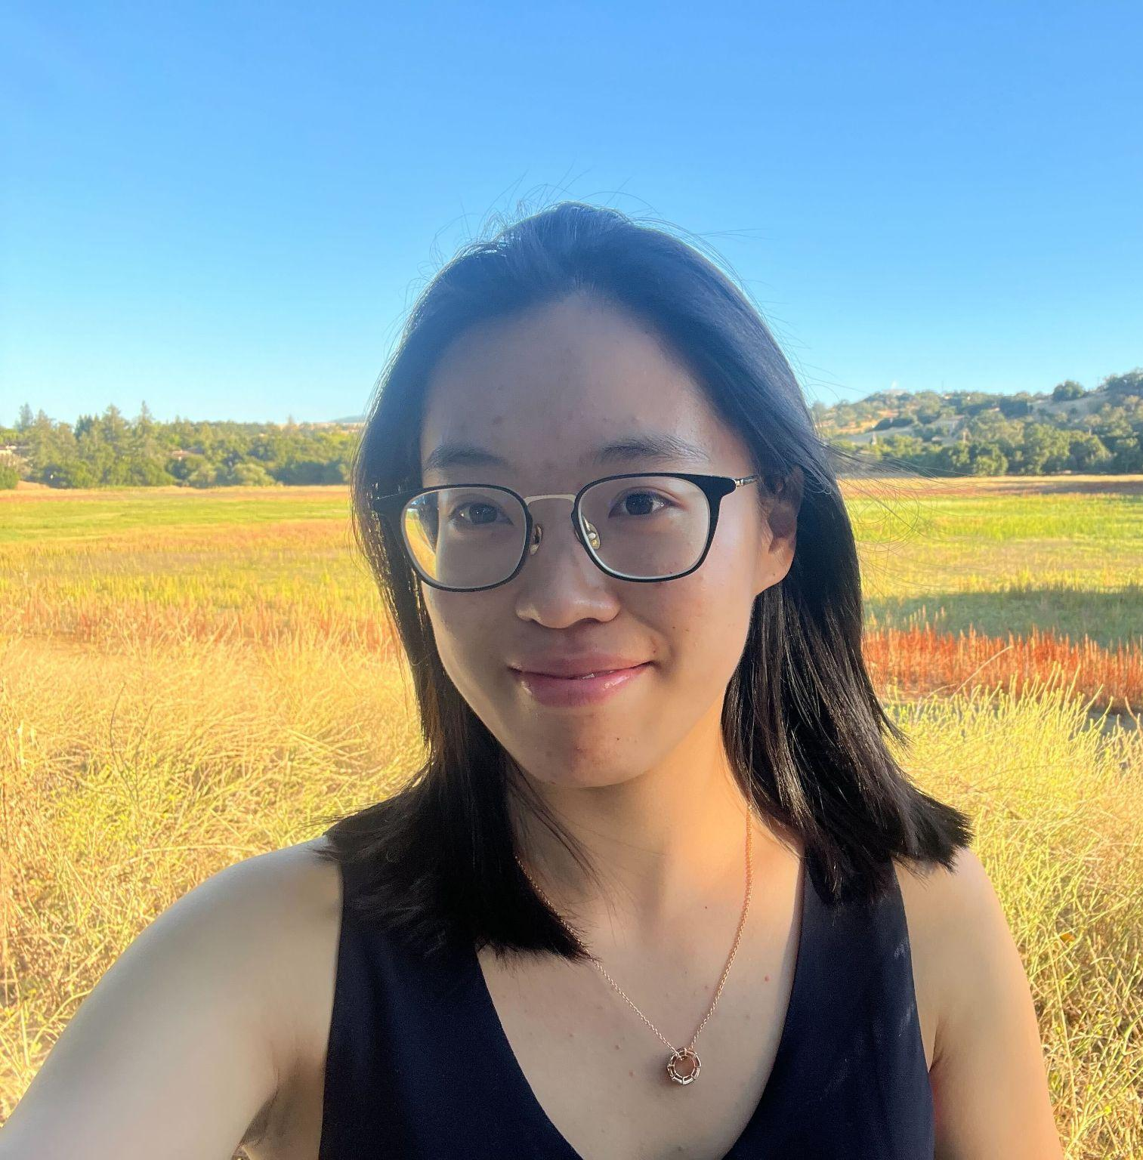



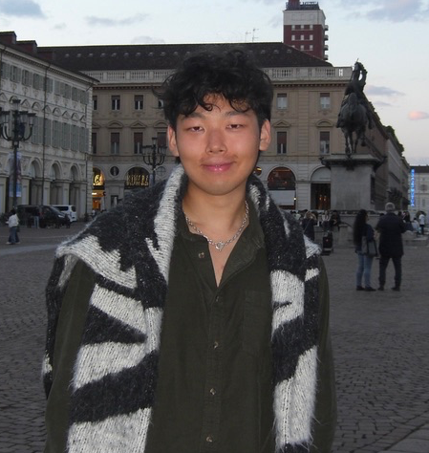
OUR TEAM
Madison Huang
Sunny
Yu
Teddy Hickenlooper
Peter
Lee
Vardhan Agrawal
Andrew
Lee
Data Analytics & Strategy
Engineering & Research
Business Analytics & Financials
Marketing & GTM Strategy
AI & HCI
Product & Engineering

Slide 4

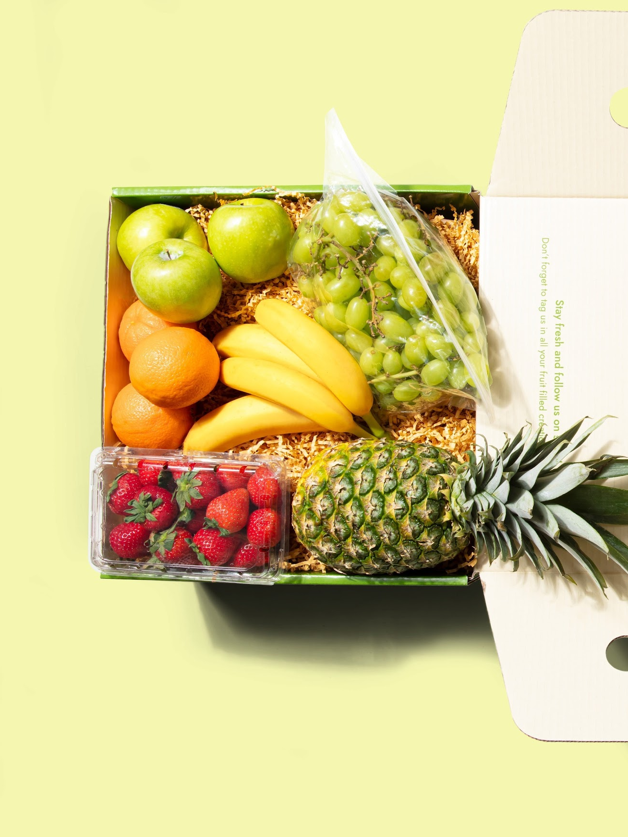
PRODUCT INTRODUCTION
FarmLink is a subscription-based farm-to-table marketplace that connects urban consumers directly with local farmers.
Notes:
make the description bigger
change the photo – image should be an online market place

Slide 5
CONSUMERS
2. PARTNERS
PRODUCT INTRODUCTION
3. SCALE
4. VALUE
Conscious consumers pay $75/week for a curated box of seasonal, local, and organic produce.
We currently have 500 farmer partners that provide produce for our weekly boxes.
Since our founding in 2020, we’ve reached 50,000 monthly subscribers across across Seattle, Portland, San Francisco, Denver, and Austin.
FarmLink isn't just about organic produce, it's about supporting local agriculture, reducing food miles, and creating community connections.

Slide 6
DELIVERY INFLEXIBILITY
01
FALSE LOYALTY
THE PROBLEM
02
MARKET PRICING
03
TECH DOESN’T SCALE
04
78% of churned customers mention delivery windows as a concern. Never experimented.
45% pause subscription quarterly, 8.3% monthly churn (up from 5%), avg retention is 6 months.
TAM capped at 100K households at $75/week. Instacart's $35 order beats our $75 box every time.
Routing crashes above 500 deliveries/city/day, and app load time is > 8 seconds.
Notes:
Delivery inflexibility is #1 churn driver
78% of churned customers cited delivery windows as primary frustration
We've NEVER tested same-day or flexible windows
False loyalty
45% pause subscription quarterly
8.3% monthly churn (up from 5%)
Average retention: only 6 months
Pricing out the market
67% would accept regional sourcing for 30% price reduction
TAM capped at 100K households at $75/week
Instacart's $35 order beats our $75 box every time
Tech can't scale
Routing crashes above 500 deliveries/city/day
App takes 8 seconds to load
Farmers ignore our "predictive analytics" (12% usage)
make text bigger

Slide 7

PROBLEM STATEMENT
Delivery Inflexibility
opportunities
data and examples to support this

Slide 8
$25,000,000
REVENUE LAST YEAR
OUR NUMBERS
50,000
SUBSCRIBERS
15
EMPLOYEES

Slide 9
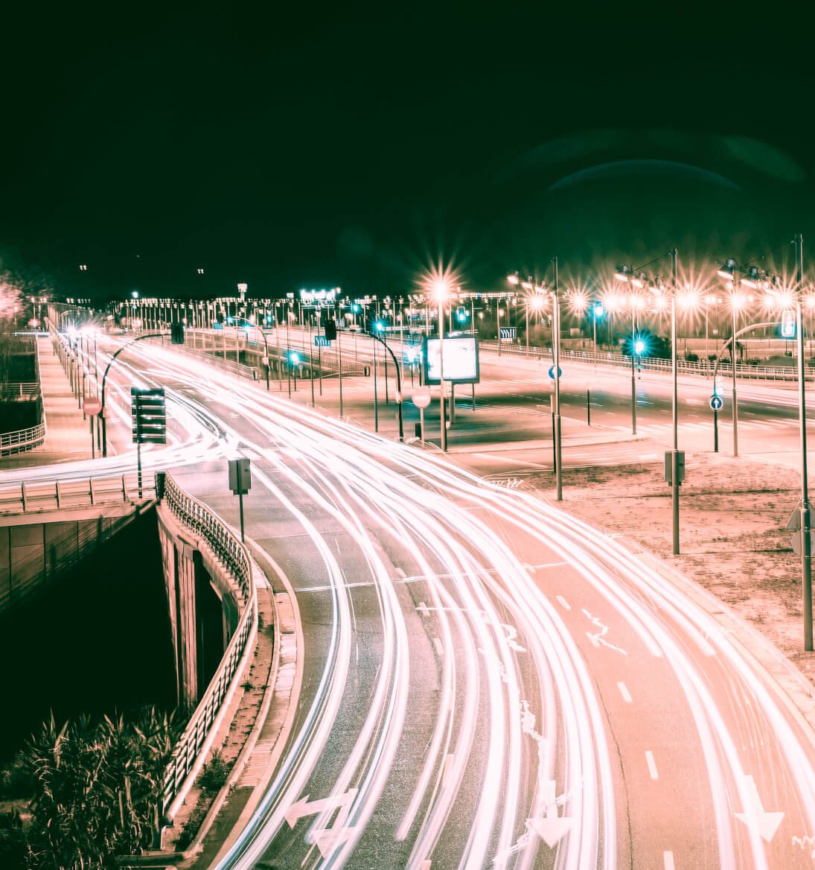

Business Model

Slide 10
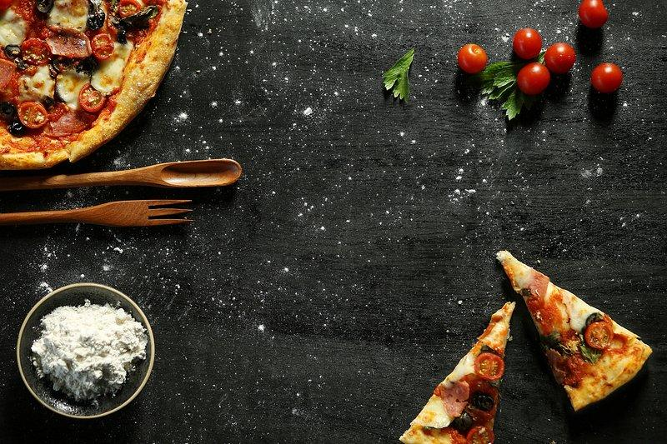
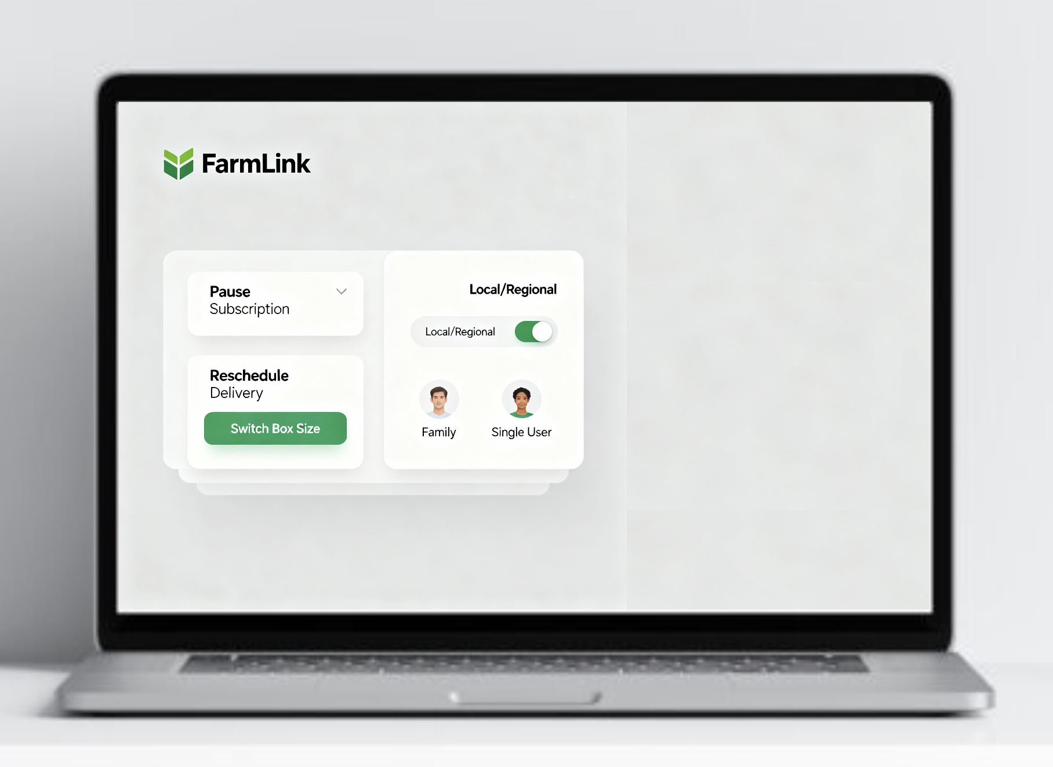
FarmLink Flex
THE SOLUTION
Local Produce, On Your Terms.
FarmLink Flex is a full revitalization of FarmLink’s tech stack, complete with a new user interface, an updated delivery management system, and expanded capacity to take on the growth of FarmLink.
Notes:
To respond directly to the convenience and price needs of the broader market, we’re introducing FarmLink Flex: a fully customizable produce subscription. Customers can now choose flexible delivery windows, box sizes, or even regionally sourced options for those seeking lower prices but fresher-than-supermarket food. We’ve designed FarmLink Flex so anyone can experience local produce without trade-offs on lifestyle or budget constraints.

Slide 11

What FarmLink Flex Offers
Regional Farms
Online Customization
The Best Home Delivery
The Same Fresh Meals
Improved range and supply chain management with a revamped internal system
Full tech stack revitalization and a brand new app changes the user experience entirely
Your selected produce box delivered to your door, when you want it..
Cook with the same top-quality ingredients and discover new recipes each week.

Slide 12

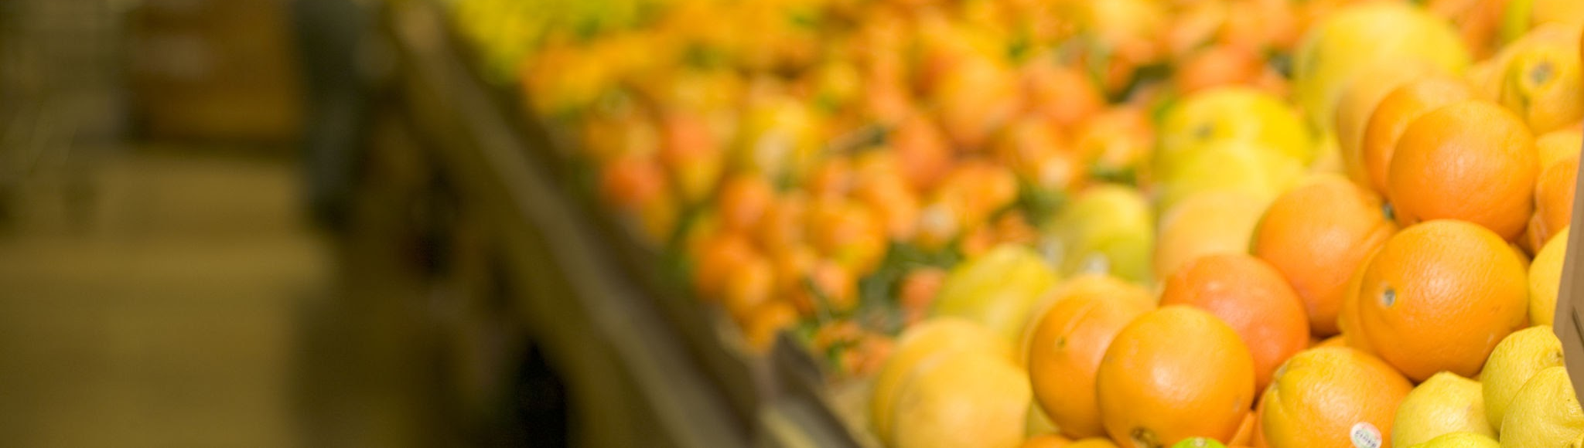

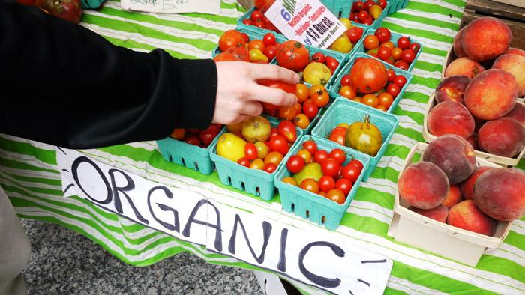
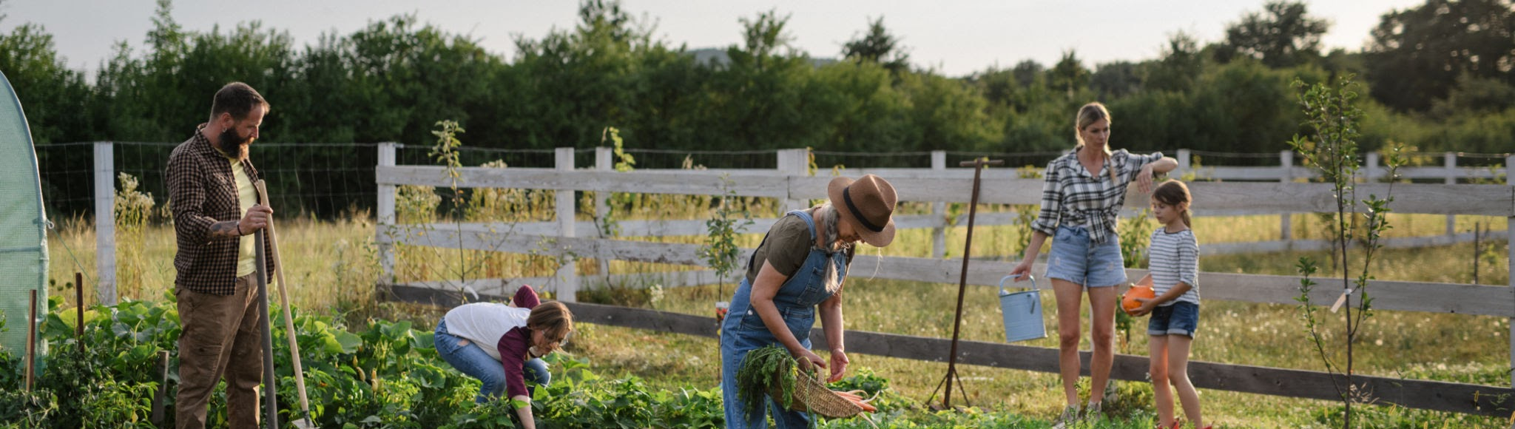
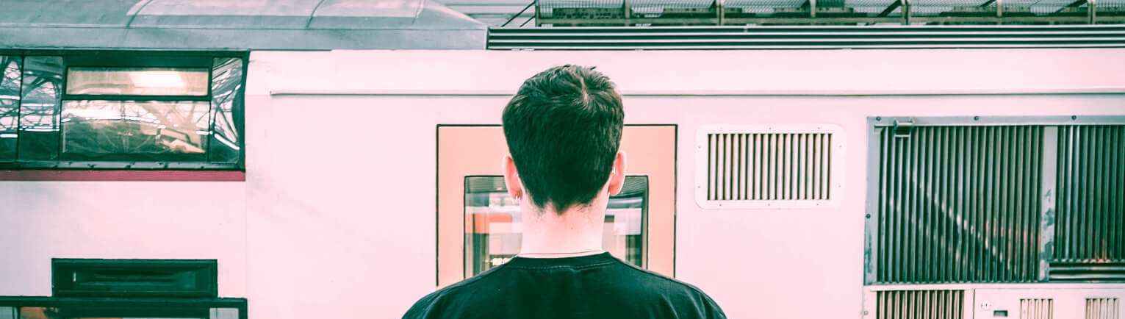
TAM/SAM/SOM
TAM
SAM
SOM
The U.S. Grocery Delivery market is anticipated to achieve revenue of $327.72 billion in 2025, with projections to reach $488.08 billion by 2030, growing at a CAGR of 8.29%. [1]
The USDA 2022 Census of Agriculture reported that producers sold $17.5 billion in food, including both unprocessed and processed (value-added) food, direct to consumers. [2]
Currently, Farmlink captures a tiny portion of the market with just $25M in revenue across 5 cities. Through our two pronged solution, we plan to pilot regional in 2 new cities, SF/San Jose and LA/San Diego, with a combined population of 6.3 million people. With this expansion and a tech stack revamp we plan to increase revenue to at least $115M.
Notes:
sources:
[1] Grocery Delivery - United States | Statista Market Forecast
[2] Community Supported Agriculture | National Agricultural Library

Slide 13
MARKET ANALYSIS
Differentiation Matrix
Feature | FarmLink Flex | Imperfect | Instacart | CSAs
Local sourcing | ✓✓ | ✓ | ✗ | ✓✓
Flexibility | ✓✓ | ✓ | ✓✓ | ✗
Price | ✓ | ✓✓ | ✓ | ✓
Tech experience | ✓✓ | ✓ | ✓✓ | ✗
Farmer support | ✓✓ | ✓ | ✗ | ✓✓
Direct Competitors:
Imperfect Foods - $150M revenue, regional, rescued produce angle -> OUR MOAT: Better farmer relationships, community focus
Misfits Market - $300M revenue, discount positioning, national scale -> OUR MOAT: Quality curation, not "ugly produce"
Local CSAs - Fragmented, $B market, pickup-only, no tech -> OUR MOAT: Tech platform, consistency, flexibility
Indirect Competitors:
Instacart - Convenience, broad selection, same-day delivery -> OUR MOAT: Better quality, sustainability story, farmer connection
Whole Foods/Amazon Fresh - Brand trust, infrastructure -> OUR MOAT: Actually local, transparent sourcing
Primary Differentiation: Hyper-local (<50 mi), authentic farmer relationships (500+), quality curation

Slide 14
FarmLink Flex Pilot Program
FarmLink Flex: Tech Revamp
FINANCIAL STRATEGY
Market Opportunity:
New app with better UX reduces bounce rate, could lower customer acquisition cost from $75 to ~$50
Increasing retention: Fixing delivery window issues could reduce 8.3% monthly churn to 5-6%
Current 500 delivery/city/day limit blocks expansion; fixing enables 2-3x capacity
Revenue impact: 3x subscriber base (50K → 150K subscribers) × $75/week × 52 weeks = $585M potential at current pricing, $390M with FarmLink Flex, capturing $50-75M realistically
Market Opportunity
FarmLink currently serves ~5 metro areas with 50K subscribers. The top 50 U.S. metro areas represent ~180M population (vs. ~50M in FarmLink's current 5 cities)
FarmLink Flex Pilot Model:
We would start with a 2-city pilot in the Bay Area and San Diego/LA.
Reduces costs by 20-30% with regional capabilities,, enabling competitive pricing
Launch at $50-55/week price point (vs. current $75)
Partner with Uber/DoorDash for same-day delivery (78% of churned customers cited delivery windows)
Financial Projections:
Conservative: 100K new subscribers @ $50/week = $260M annual revenue, capturing $40M realistically
Moderate: 350K new subscribers @ $52/week = $946M annual revenue, capturing $132M realistically
Aggressive: 500K new subscribers @ $55/week = $1.43B annual revenue, capturing $200M realistically
Total Investment Required: $1M for complete platform rebuild (could likely be done more cheaply with AI software engineering), and $1-2M for pilot expansion.

Slide 15

SNEAK PEEK
Mercury is the closest planet to the Sun and the smallest one in the Solar System—it’s only a bit larger than our Moon. The planet’s name has nothing to do with the liquid metal, since it was named after the Roman messenger god, Mercury

Slide 16
OUR ASK
STRATEGIC APPROVAL
Green light for FarmLink Flex three-tier model
BUDGET ALLOCATION $2.5M over 6 months
$800K: Logistics tech partnership and integration
$500K: App/platform improvements
$600K: Two-city pilot marketing spend
$400K: Regional farmer onboarding and support
$200K: Research and testing
RESOURCE COMMITMENT
product team (3 engineers, 1 designer, 1 PM)
TIMELINE AUTHORITY
2-month decision window for pilot results

Slide 17
NEXT STEPS
WEEK 2
WEEK 4
Launch farmer outreach in pilot cities.
Develop and launch marketing campaigns.
WEEK 1
WEEK 3
WEEK 5
Secure logistics partner, kick off technical builds
Begin customer research interviews and A/B testing..
Soft launch in
Palo Alto.

Slide 18
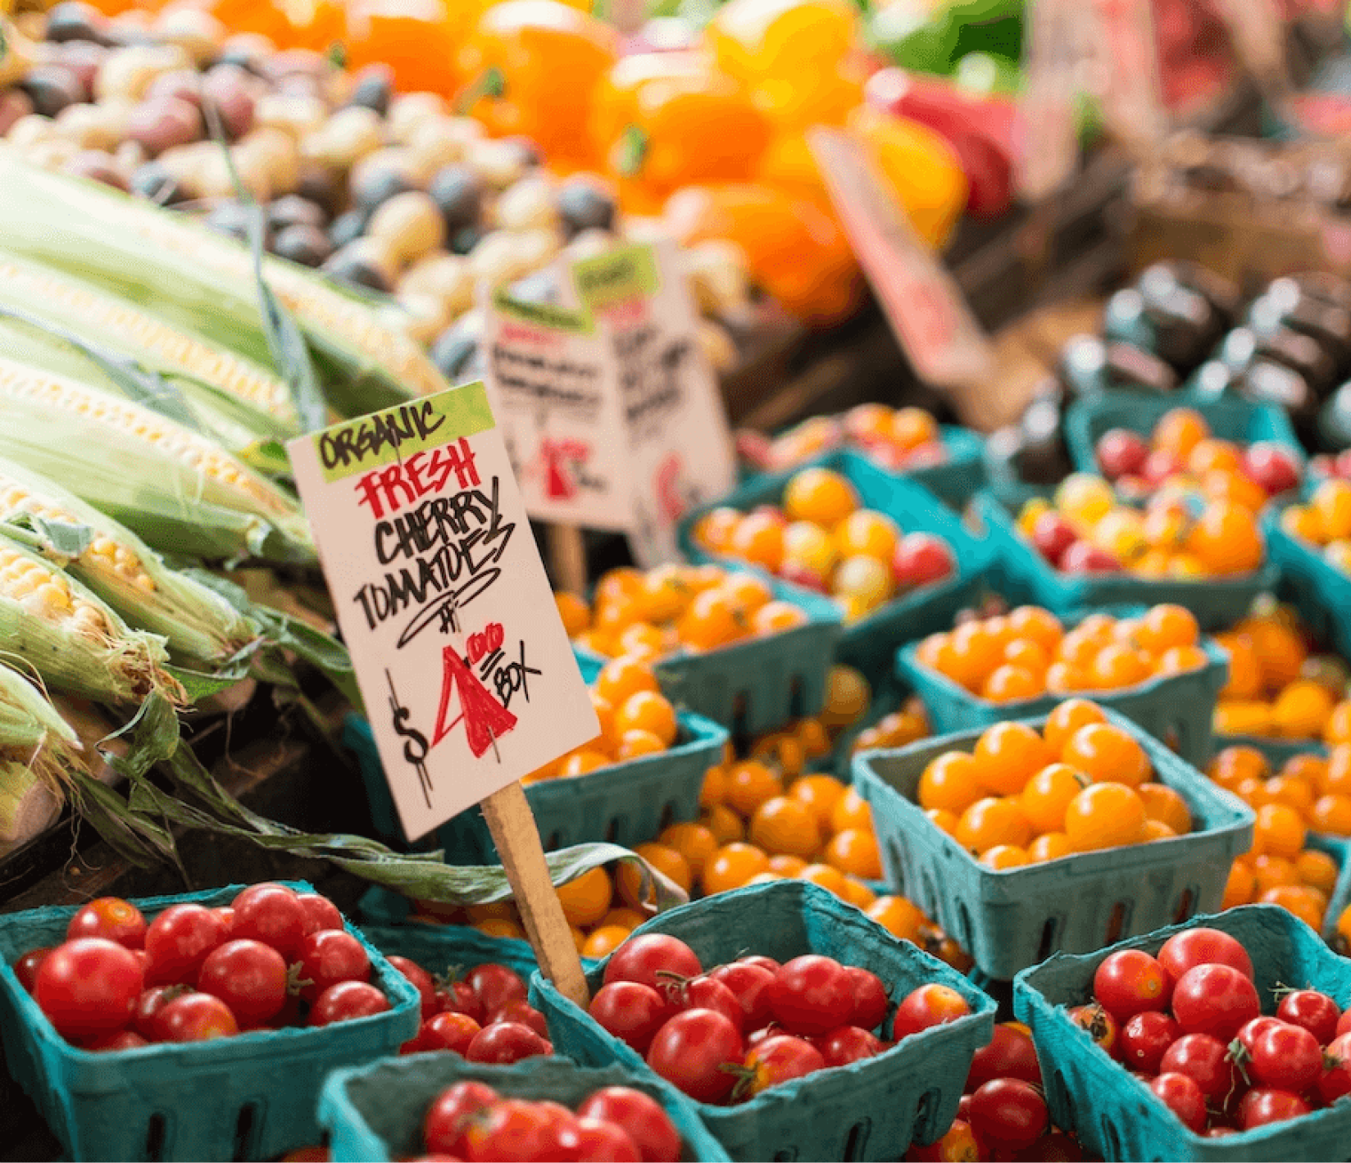
THANK YOU!
FarmLink - Team 7

Slide 19
APPENDIX
References
[1] Grocery Delivery - United States | Statista Market Forecast
[2] United States Online Grocery Market Size & Forecast to 2033
[3] Renub
[4] Community Supported Agriculture | National Agricultural Library
[5] The Size and Scope of Locally Marketed Food Production | Economic Research Service
[6] US Meal Kit Delivery Services Market
[7] Organic Agriculture | Economic Research Service
[8] Growth of U.S. Organic Marketplace Accelerated in 2024 | OTA
[9] Grocery Delivery - United States | Statista Market Forecast
[10] The next S-curve of growth: Online grocery to 2030 | McKinsey
[11] eGrocery Lookout: Market Trends
[12] United States Organic Food Market Size & Forecast to 2033

Slide 20
OUR LOCATIONS
Mercury is the closest planet to the Sun and the smallest one in the Solar System

Slide 21


OUR TEAM
You can replace the image on the screen with your own
You can replace the image on the screen with your own

Slide 22

ALTERNATIVE RESOURCES
Here’s an assortment of alternative pictures within the same style of this template.
Airplane window with sky and sea landscape
Railway train station long shot
One way road sign in the city
Sunset at bay
Old foot bridge over the river near alesund; norway
Tropical road with desert background
Modern woman riding bike in city
Harbor with boats and blue sea
City roads at night
Brooklyn bridge and new york
If you want to apply the same filter as the pictures already included in the template, follow these instructions.
In Photoshop:
Open the picture in Photoshop.
On the Layers panel, click the Create New Adjustment Layer button.
Select Photo Filter and click Color.
Paste this hex code: #908269
Adjust the density to increase or decrease the filter effect.
In Google Slides / PowerPoint:
Create a new shape with the same shape as the photo to which you want to apply the filter.
Select the color for the filter (#908269) and reduce the opacity until you’re happy with the result.
If you want to modify the photo, move the filter to a side first.

Slide 23
Ask

